Slide 1
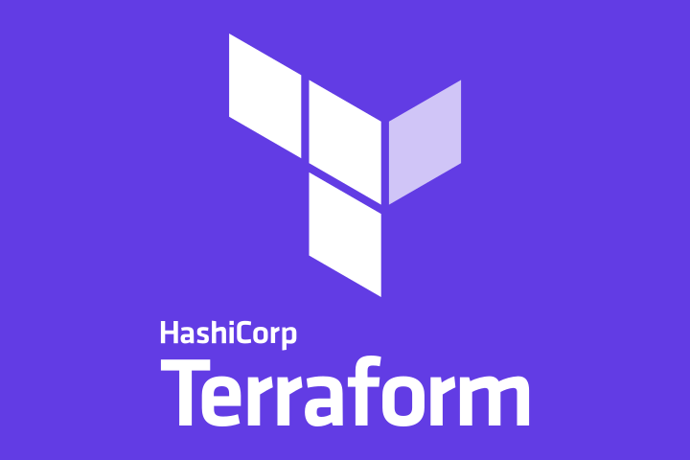
TERRAFORM Infrastrcture As A Code(IAAC)
Presentation By
Balasubramanyam B

Slide 2
what is Terraform?
Terraform is one of the most popular Infrastructure-as-code (IaC) tool, used by DevOps teams to automate infrastructure tasks.
It is used to automate the provisioning of your cloud resources. Terraform is an open-source, cloud-agnostic provisioning tool developed by HashiCorp and written in GO language.

Slide 3
How Terraform can improve your DevOps process
Terraform allows DevOps Engineers to automate and manage the Data Center Infrastructure, the platforms, and the services that run on those platforms, all from one location, that you can reuse and share.
Instead of handling the infrastructure manually by logging into the AWS Web Console to create each component of your infrastructure, you just do it in code. AUTOMATION

Slide 4
Advantages
Infrastructure as Code
Multi-Cloud Support
Flexibility
Code reusability

Slide 5
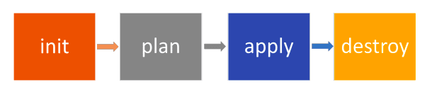
Terraform Lifecycle
Terraform init runs a number of initialization tasks to enable Terraform for use in the current working directory.
Terraform plan It is preview of resources what we going to create. It also compares the desired Terraform state with the current state in the cloud and builds and displays an execution plan for infrastructure creation or destruction.
Terraform apply Apply the plan from the plan phase. This will create your resources, which means it potentially changes the deployment by adding resources based on changes in the plan.
Terraform destroy will delete all resources that are created/managed by the Terraform environment you are working in.

Slide 6
Terraform in action
provider "aws" {
region = "us-east-1"
access_key = ""
secret_key = ""
}
In Terraform, a provider is a plugin that serves as an interface between Terraform and an external system, such as a cloud provider or an API.
Providers enable Terraform to support a wide range of infrastructure platforms and services. Some popular providers include AWS (Amazon Web Services), Azure (Microsoft Azure), GCP (Google Cloud Platform), and many others.

Slide 7
Blocks
resource "aws_instance" "pub_ec2-1" {
ami = "ami-090e0fc566929d98b"
instance_type = "t2.micro"
count = 1
key_name = "testkey"
vpc_security_group_ids =["${aws_security_group.web_sg.id}"]
subnet_id = "${aws_subnet.MyPubSn-1.id}"
associate_public_ip_address = true
user_data = "${file("data.sh")}"
tags = {
Name = "publicec2-1"
}
}
<BLOCK TYPE> "<BLOCK LABEL1>" "<BLOCK LABEL2>" {
# Block body
<IDENTIFIER> = <EXPRESSION> # Argument
}

Slide 8
Task -1
Create a vpc
Create Subnets
Create an Internet Gateway and NAT gateway
Create Route table
Configure Security Group
Create EC2 instances
Create Load Balance and RDS

Slide 9
EC2 – Instance Creation
In this example, the EC2 instance is created in one file named ec2_create.tf
resource "aws_instance" "pub_ec2-1" {
ami = "ami-090e0fc566929d98b"
instance_type = "t2.micro"
count = 1
key_name = "testkey"
vpc_security_group_ids =["${aws_security_group.web_sg.id}"]
subnet_id = "${aws_subnet.MyPubSn-1.id}"
associate_public_ip_address = true
user_data = "file("data.sh")
tags = {
Name = "publicec2-1"
}
}

Slide 10
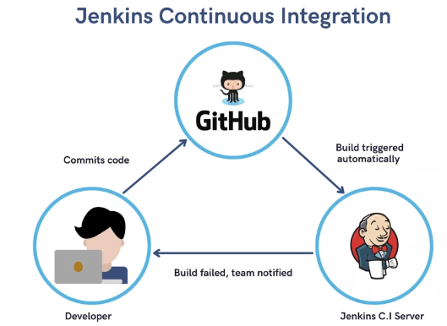

Jenkins
Kohsuke Kawaguchi first developed Hudson in 2004
Oracle acquired Sun Microsystems in 2010
On January 2011, First Jenkins project created.

Slide 11
Features of Jenkins
Jenkins has some features that really sell it as a CI/CD tool. These are some of them:
Plugins
Easy to set up
Supports most environments
Open-source
Easy distribution

Slide 12
Jenkins Installation Procedure
Launch an Amazon Linux Instance
Connect to the EC2 Instance
Execute below commands
sudo yum update –y
sudo yum install java-1.8.0-openjdk-devel -y
sudo wget -O /etc/yum.repos.d/jenkins.repo https://pkg.jenkins.io/redhat-stable/jenkins.repo
sudo rpm --import https://pkg.jenkins.io/redhat-stable/jenkins.io.key
sudo yum install jenkins -y
sudo service jenkins start
sudo cat /var/lib/jenkins/secrets/initialAdminPassword
Paste the admin password and create user and login into Jenkins page

Slide 13
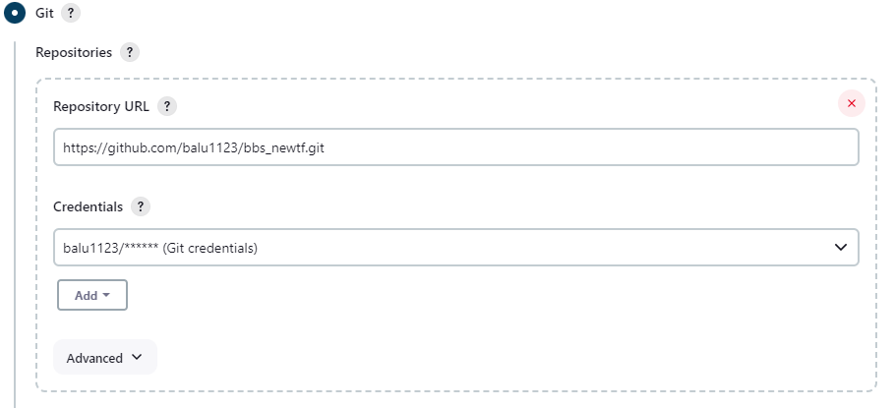
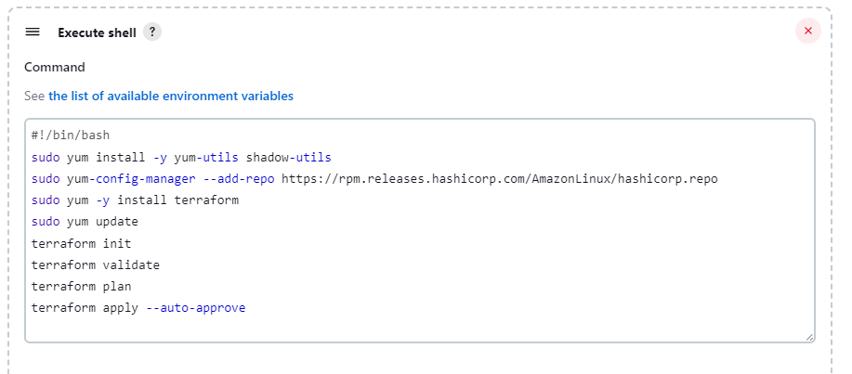
Jenkins config for Terraform deployment

Slide 14
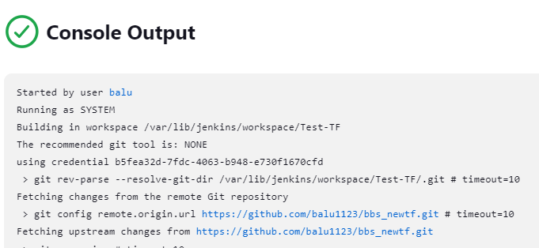
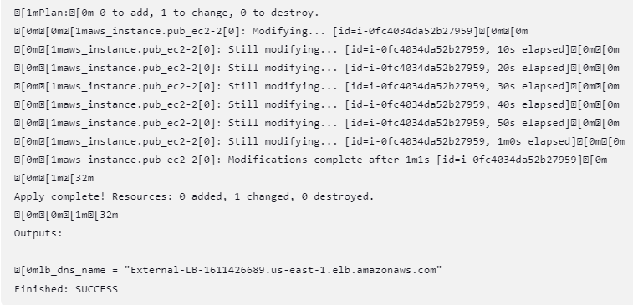
Output

Slide 15


